Slide 1



V
December 18, 2024
My Weekly
Updates
Song-Ze, Yu

Slide 2
01
INTRODUCTION TO SYNTHESIZERS
Quickly
Rewinds
02
PYTHON IMPLEMENTATION AND DEMO
These are goals I’m working on based
on the goal of making an AI plugin for the year.
03
CONCEPTUAL FRAMEWORK FOR AN AI SYNTHESIZER

Slide 3
01
POSSIBILITY OF AI SYNTHESIZERS
02
Content
CHANGING THOUGHTS TO DUPLICATE TIMBRE
03
What I’ll cover today of things have learned and done these days.
Song-Ze, Yu
OPEN TO NEW IDEAS

Slide 4
Create my own dataset
先手動建一筆dataset，可能用splice或者一些業界有名的合成器plugin的每個音色去建label，可能花一個寒假把每個音色寫三個最相應的形容詞之類的（啊總共有哪些形容詞這也要事先定義好大小跟範圍）

Slide 5
Changing Thoughts To Duplicate Timbre
試著以eq compressor reverb modulation各挑幾個最重要的參數去做傳統模型的訓練
（時間許可可以延伸到用cnn來做深度學習 但因為這個還要牽扯到每個epoch必須把以目前的weight算出來的參數去生成出音檔 然後才能用頻譜圖去算loss function 這會很複雜而且蠻有難度的）

Slide 6
Create my own dataset
暫時打算直接用logic pro的stock presets，選一種樂器譬如鋼琴類的
先把他個presets使用的參數抓出來打算當模型的feature、然後設計可能彈基本的單音音階到常見的和弦走向然後跟一些可能合在一起的 （what’s next: 要怎麼設計、音檔要多長要再花時間好好想）

Slide 7
Create my own dataset
但原則上用這個方法 我就一直用同一組midi檔把presets每個plugins都關掉輸出當成input、再開回來當ground truth 就成功做出一筆dataset了

Slide 8
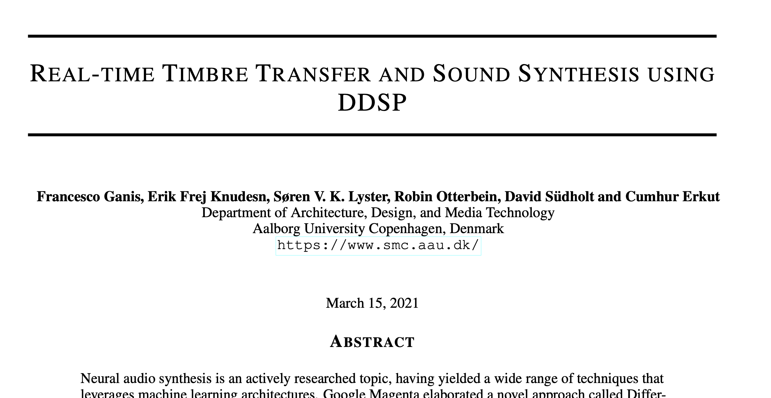
Related works

Slide 9
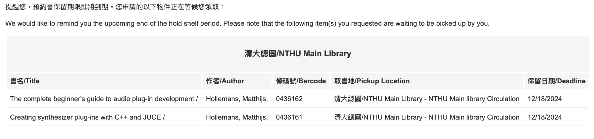
What’s next?

Slide 10

V
Thank you!
Now, what’s next?

Slide 11
03
CONCEPTUAL FRAMEWORK FOR AN AI SYNTHESIZER
• How can AI generate sound based on textual descriptions?
• Example: “I want a soft and airy sound.”
• Requires extracting features from the description, like “soft” indicating a sine wave and “airy” implying low-pass filtering.

Slide 12
Traditional Sound Design Workflow
• How humans create sound:
1. Select a basic waveform (sine, sawtooth, etc.).
2. Adjust brightness and resonance using filters.
3. Set dynamic parameters like ADSR.
• Limitation: Manual design relies heavily on experience and trial-and-error.

Slide 13
AI Synthesizer Workflow
• Step 1: Analyze the input description
• Use NLP (Natural Language Processing) to extract key features (e.g., “soft”, “bright”, “metallic”).
• Step 2: Map features to synthesizer parameters
• Key features → Basic waveform:
• Example: “Soft” maps to sine wave, “sharp” maps to sawtooth wave.
• Key features → Filters:
• Example: “Dark” maps to a low-pass filter, “bright” maps to a high-pass filter.
• Key features → ADSR:
• Example: “Sustained” maps to long sustain, “snappy” maps to short attack.
• Step 3: Train an AI Model
• Workflow:
1. Generate initial sounds based on input descriptions.
2. Refine the generated sounds with user feedback using reinforcement learning or fine-tuning.

Slide 14

Other Updates
FPGA synthesizer report and paper reading
try running model and training on AHG workstation.

Slide 15

Timeline
OCT.31
using juce to create an easy plugin
AI mixing or mastering:
how to collect datasets for training?
Cambridge Music Technology Multitracks
..... AI EQ?
Cambridge Music Technology Multitracks
LLM based Synthesizer

Slide 16

Special Projects
These are projects from other teams asking for our assistance.
01
02
03
UPDATE TRAINING MANUAL FOR REAL ESTATE AGENTS
DESIGN PROPERTY LISTING COLLATERALS
CREATE PROPERTY LISTING PRESENTATION TEMPLATE

Slide 17

The editorial plan includes references to updated website content, including property listings.

Slide 18

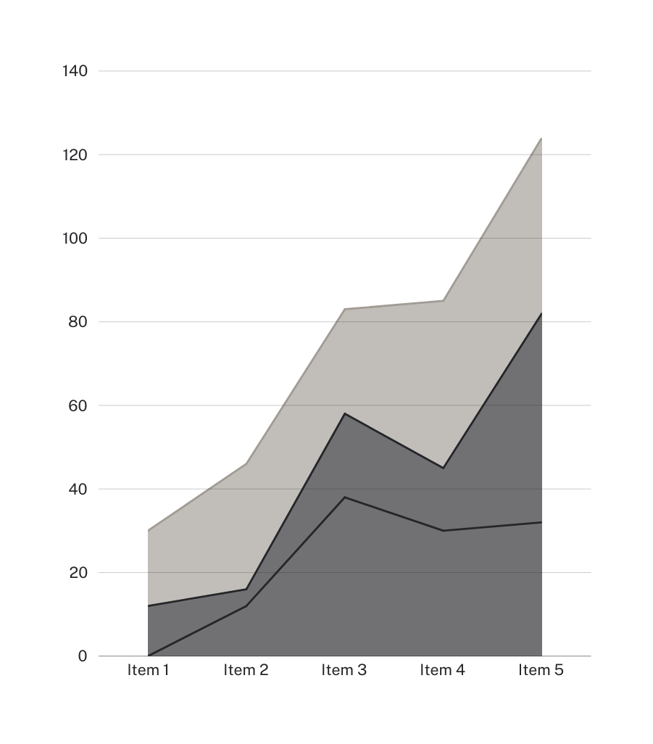
We learned
that social media posts on real estate tips are the most liked and shared.

Slide 19
Other Updates
New property listings will be posted
twice a week starting next month
The number of inquiries and appointment requests sent through the website increased by 20% after the redesign
Training manual for real estate agents
is under review by the manager

Slide 20

Action Items for Next Week
Complete blog content review
and update
Submit next month's social media editorial calendar for review
Finalize editorial calendar for the real estate newsletter

Slide 21






























Free Resources
Use these free recolorable icons and illustrations in your Canva design

